Slide 1

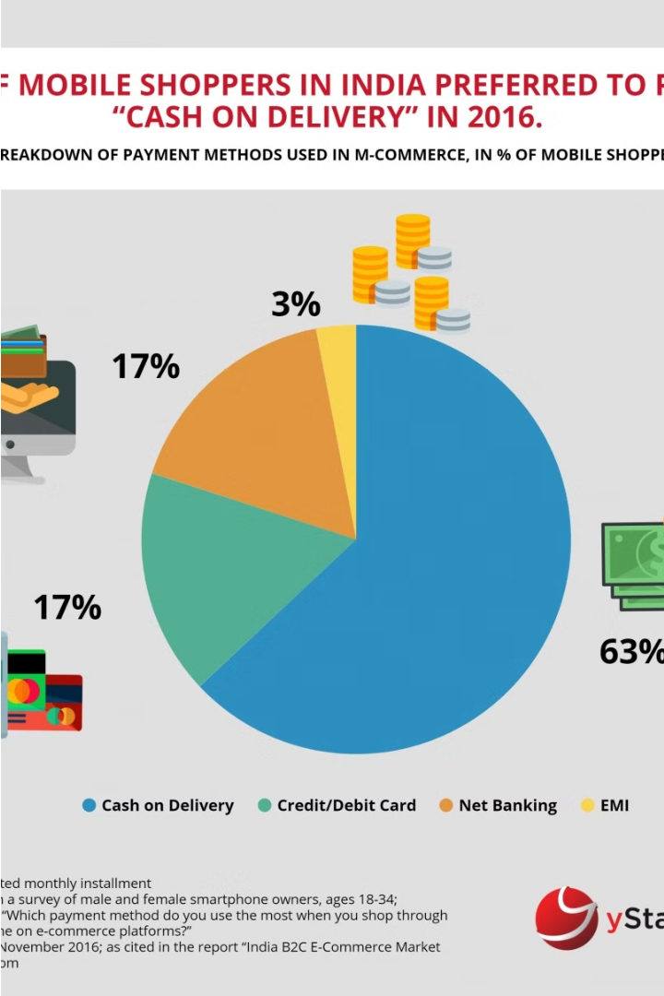
Analyzing E-commerce Success in India
This presentation examines the key drivers behind successful customer acquisition and retention strategies in the rapidly evolving Indian e-commerce landscape. Leveraging data-driven insights, we'll explore the critical factors that unlock sustainable growth for online retailers.
By - Gitanshu Saxena
Designation - AI/ML Intern
Company - Meta Scifor Technologies

Slide 2
Introduction to E-retail Success Factors
Importance of Customer Satisfaction
Focus on Indian Online Shoppers
Key Success Factors
The study will examine factors such as service quality, system quality, information quality, trust, and net benefit, and their impact on customer activation and retention.
In the highly competitive e-commerce landscape, customer satisfaction is paramount. Retaining loyal customers and driving repeat business are key to unlocking long-term e-retail success.
This analysis will dive into the unique needs and preferences of Indian online consumers, who represent a rapidly growing and lucrative market for e-retailers.

Slide 3


Data Overview and Preprocessing
Data Loading
1
Dataset read from Excel and converted to CSV for handling.
Initial Inspection
2
Displaying first few rows and setting display options.
Reading CSV Data
3
Loading data into a Pandas DataFrame.
The first step in the data analysis process was to load and inspect the dataset. The Excel file containing the e-commerce data was read and converted to a CSV format for easier handling. Initial exploration involved displaying the first few rows of the data and configuring the display options to show all columns and rows. Finally, the CSV data was loaded into a Pandas DataFrame for further analysis.

Slide 4
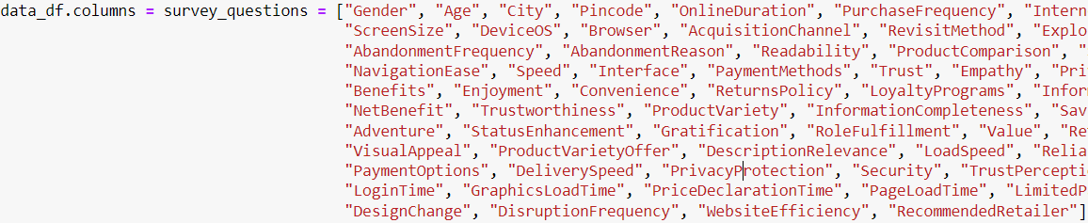



Data Cleaning
Renaming Columns
Renamed the column names in the dataset to improve readability and understanding of the survey questions.
Dropping Unnecessary Columns
Removed irrelevant columns such as ScreenSize, DeviceOS, NetBenefit, TrustPerception, and AssistanceAvailability to focus the analysis on the key factors.
Further Cleaning
Dropped the Trust and Pincode columns to simplify the dataset and prepare it for more in-depth analysis.

Slide 5
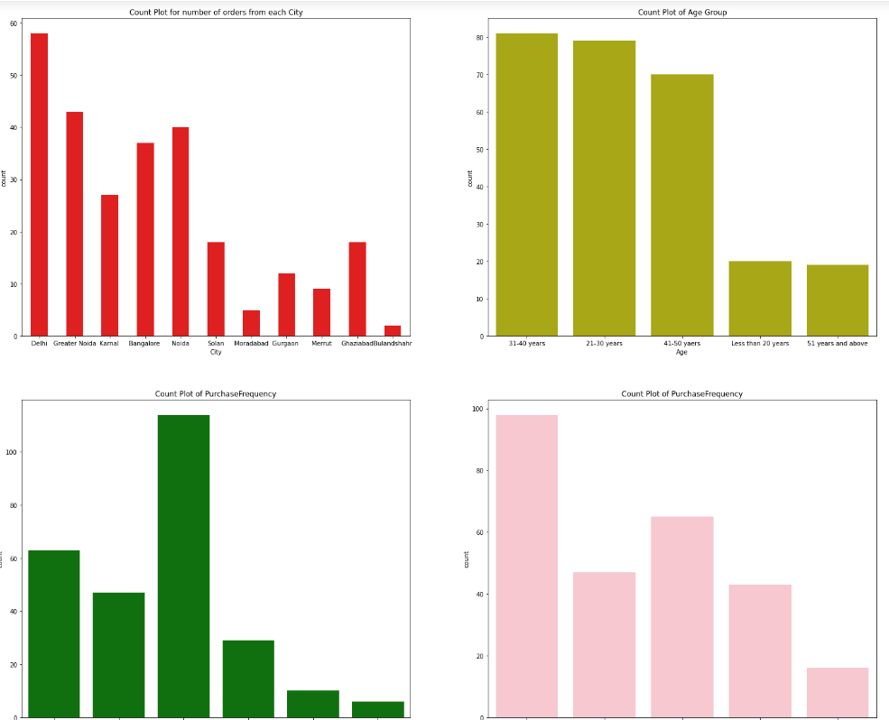
Visualizing Data
The data visualization analysis begins with examining key demographic factors. Count plots are used to analyze the distribution of cities, age groups, purchase frequency, and online duration of the e-commerce customers.
These visualizations provide a clear picture of the customer base and help identify trends and patterns in the data that will inform the subsequent analysis.

Slide 6



Correlation and Multicollinearity
Correlation Matrix
1
Identify highly correlated features
VIF Scores
2
Measure multicollinearity
Insights
3
Uncover underlying relationships
The correlation analysis helps identify highly related features in the dataset, which is important for avoiding multicollinearity issues in the predictive models. Additionally, the variance inflation factor (VIF) scores provide a quantitative measure of multicollinearity, allowing us to pinpoint the variables that may need to be removed or transformed to improve model performance.

Slide 7




Insights from Analysis
Demographic Insights
Age Distribution
Purchase Behavior
Correlation Insights
The analysis revealed that the predominant age groups among shoppers were millennials and Gen Z, highlighting the importance of understanding their unique purchasing behaviors.
Patterns in shopping frequency and online duration provided valuable insights into customer engagement and retention strategies for the e-commerce platform.
The identification of highly correlated features allowed for potential feature reduction, simplifying the model and improving its performance.
The data showed a concentration of orders in specific cities, indicating potential regional preferences among shoppers.

Slide 8
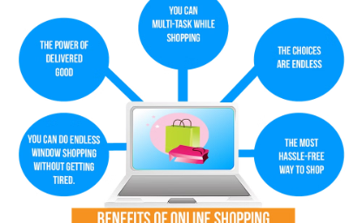
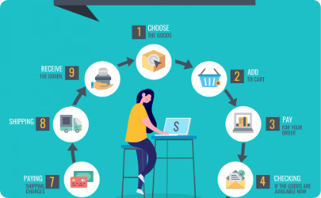
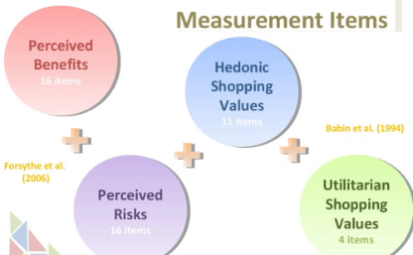
Conclusions and Recommendations
Enhance Service and System Quality
Focus on Detailed Product Info and Trust
Balance Utilitarian and Hedonistic Factors
Investing in seamless user experiences and reliable, efficient systems is crucial to meeting customer expectations and driving repeat business.
Providing comprehensive, transparent product details and fostering trust through secure transactions and responsive support builds customer confidence.
Optimizing the blend of practical and enjoyable aspects of the e-retail experience can powerfully boost customer loyalty and repeat purchases.

Slide 9
Next Steps
Further Actions
Acknowledgment
Continue data cleaning and feature selection to refine the analysis. Explore potential for modeling and predictive analysis based on the insights gained.
Thank you for your attention and engagement with this e-retail success factors presentation. We appreciate your time and look forward to discussing the next steps.

Slide 10
Questions and Answers
Feel free to ask questions and engage in discussions related to the analysis of customer activation and retention factors in Indian e-commerce. This open dialogue allows for deeper understanding and potentially identifies additional insights that could inform future strategies.

